Slide 1
Agentic AI for Engineering
Lesson 1
Introduction to Git and GitHub
Hands-on with GitHub Desktop
Version control skills for working with coding agents
USAFA Instructor Short Course
Notes:
Welcome. Lesson 1 covers the version control skills everyone needs before we hand a repository to a coding agent in Lesson 2. No prior Git experience is assumed. We'll spend about 15 minutes on concepts, 30 minutes of guided exercises with GitHub Desktop, and 5 minutes on review.

Slide 2
Lesson Objectives
By the end of this lesson you can:
Overview
1
Explain what Git and GitHub each do, and how they differ
2
Clone, commit, push, and pull with GitHub Desktop
3
Use branches and pull requests to review a change before it reaches main
4
Resolve a simple merge conflict and undo a change
5
Prepare a repository that a coding agent can work in
Agenda (50 min)
0–15 min
15–45 min
45–50
Concepts
Guided exercises in GitHub Desktop
Review
Notes:
Set expectations. The goal is practical fluency, not Git mastery. Everything we do today maps directly onto how a coding agent like Codex delivers work: it commits to a branch and opens a pull request, and you review and merge it.

Slide 3
Prerequisites
Complete before class:
Overview
GitHub account
Sign up at github.com. Use the account type your organization directs (personal or institutional). Turn on two-factor authentication.
GitHub Desktop
Install from desktop.github.com. On a managed laptop, check with IT first.
Text editor
VS Code recommended. GitHub Desktop can open repos in it directly.
MATLAB (optional)
Lets you run the practice project. Not required to learn Git.
Practice repo link
From the course lead: a link to the beam-calc template repo.
https://github.com/usafa-dfas/beam-calc
You do not need the Git command line for this course. GitHub Desktop includes Git.
Notes:
Ideally participants complete this before class. Government or managed laptops may block installs, so coordinate with IT ahead of time. Use whatever account type your organization directs; the lesson works the same either way. Course lead: before class, publish the beam-calc template repository (see practice/README.md in the course repo) and send its link with these prerequisites.

Slide 4
Why Version Control?
Without it
With Git
beam.m
beam_v2.py
beam_v2_final.py
beam_v2_final_FIXED.py
beam_v3_from_email.py
beam.m
e4f5a6b Switch to aluminum
a1b2c3d Fix units on load P
9c8d7e6 Initial version
Concepts
One file. Every saved version, with who, when, and why.
Which one is current? What changed between them, and why?
History
Undo
Parallel work
Review
See any past version
Roll back one change safely
Try ideas without breaking main
Read every line an agent changed
Notes:
Most engineers already do version control by hand with file names and email. Git does the same job with a complete, searchable record. This matters more with agents: an agent may change many files at once, and you need to see exactly what changed and be able to back it out.

Slide 5
Git vs. GitHub
Local repo
push
Remote repo
your laptop (Git)
fetch / pull
GitHub (origin)
Concepts
Git
GitHub
GitHub Desktop
Version control software. Runs on your computer. Stores history in a hidden .git folder in the project.
A website that hosts repos. Adds sharing, pull requests, and access control. Coding agents connect here.
A free app with buttons for Git commands. Links your local repo to GitHub.
Git works offline. GitHub is only needed to share or back up your work.
Notes:
Git is the version control engine. It runs on your computer and keeps history in a hidden .git folder inside your project. GitHub is a website that hosts a copy of the repository so others, including coding agents, can reach it. GitHub Desktop is a point-and-click app that runs Git for you and talks to GitHub.

Slide 6
Key Terms
Term
Meaning
GitHub Desktop
Repository
A project folder whose full history Git tracks
New / Add / Clone repository
Concepts
Clone
Download a repo from GitHub, with its history
File › Clone repository
Commit
A saved snapshot of changes, with a message
Commit to <branch>
Push
Send your commits to GitHub
Push origin
Fetch / Pull
Check for / download commits from GitHub
Fetch origin / Pull origin
Branch
A separate line of commits; main is the default
Current branch menu
Diff
Line-by-line changes: + added, − removed
Changes tab / History tab
Pull Request (PR)
A request on GitHub to review and merge one branch into another
Create Pull Request
Merge conflict
Two commits changed the same lines; you choose the result
Resolve conflicts dialog
Origin
The name for the GitHub copy of your repo
Shown on the sync button
Notes:
This is the vocabulary for the rest of the course. Lesson 2 opens with this same table as a review. Point out that the right column is the button or menu you'll click in GitHub Desktop.

Slide 7
Why This Matters for Agents
A cloud coding agent such as ChatGPT Codex works from your GitHub repo, not your laptop. The loop looks like this:
Concepts
1
2
3
4
5
You push the repo to GitHub
Agent reads the repo in its sandbox
Agent commits to a branch and opens a Pull Request (PR)
You review the diff, test, and merge
You pull the result to your laptop
Your steps (today's exercises)
Agent steps (Lesson 2)
Every agent change arrives as a commit you can read, test, and revert.
Notes:
This is the bridge to Lesson 2. Cloud coding agents such as ChatGPT Codex work from a GitHub repository. The agent never touches your laptop. It delivers changes as commits on a branch, usually with a pull request. Every skill in today's exercises is a step in that loop.

Slide 8
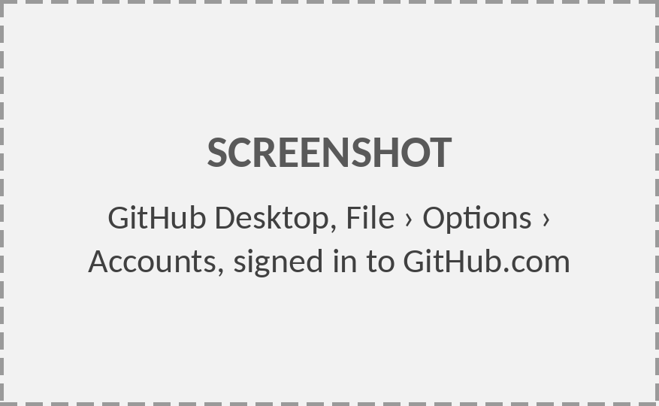
Exercise 1: Sign In & Configure
EXERCISE
1
Open GitHub Desktop.
2
File › Options › Accounts › Sign in to GitHub.com. Finish in the browser.
Setup
3
Options › Git: confirm your name and email . These label every commit you make.
4
Options › Integrations: set External editor to Visual Studio Code.
Mac: GitHub Desktop › Settings instead of File › Options.
Notes:
Exercises start here. Walk the room and confirm everyone is signed in. The name and email under Options › Git are stamped on every commit, so use your real name. On a Mac, Options is under GitHub Desktop › Settings.
Screenshot to add: GitHub Desktop, File › Options › Accounts, signed in to GitHub.com (Replace the gray placeholder: right-click › Change Picture › From a File.)

Slide 9
The Practice Project
Today’s practice project. In Exercise 2 you copy it to your own GitHub account; Exercises 3–8 change it.
beam-calc : tip deflection of a cantilever beam under a point load.
beam.m
% Cantilever beam tip deflection
E = 200e9; % Pa, steel
L = 2.0; % m, length
P = 500.0; % N, tip load
b = 0.05; h = 0.10; % m, section
I = b*h^3/12;
delta = P*L^3/(3*E*I);
fprintf('Tip deflection: %.2f mm\n', delta*1e3)
Setup
δ = P L³ / (3 E I)
beam-calc/
├─ README.md
├─ AGENTS.md
├─ .gitignore
├─ beam.m
└─ tests/
└─ testBeam.m
Output: Tip deflection: 1.60 mm
The files in the repo. You’ll edit beam.m; tests/ checks it. README.md, AGENTS.md, and .gitignore come back at the end of the lesson.
Notes:
The practice project is deliberately tiny: one script that computes the tip deflection of a cantilever beam. The engineering is trivial so attention stays on Git. Point out README, .gitignore, and AGENTS.md; we'll come back to them at the end.
The intro line and the file-list caption tell participants where this project comes from (Exercise 2) and which files matter today.

Slide 10
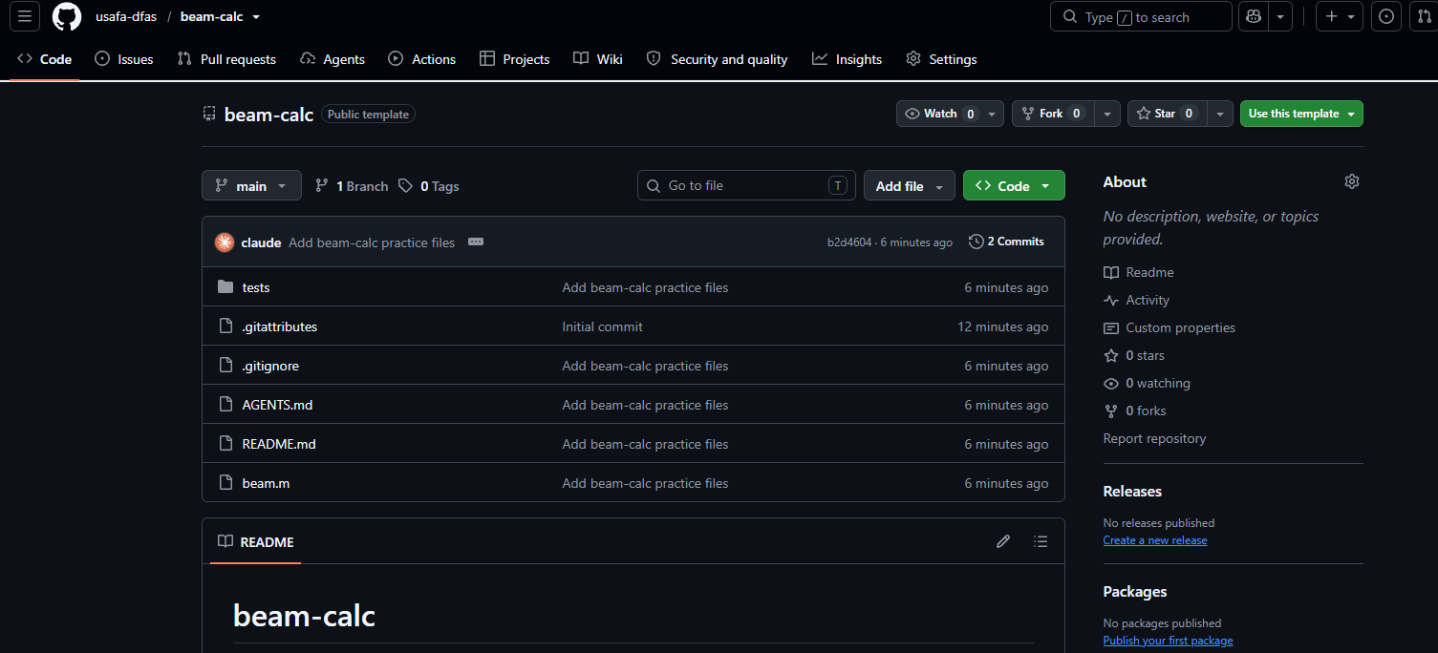
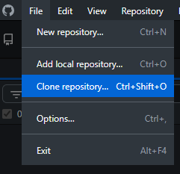
Exercise 2: Copy & Clone
EXERCISE
On GitHub (browser)
1
Open the course lead’s beam-calc link: https://github.com/usafa-dfas/beam-calc
2
Use this template › Create a new repository. Owner: you. Visibility: Private.
Clone
In GitHub Desktop
3
File › Clone repository › pick your new beam-calc.
4
Choose a local path outside OneDrive. Click Clone.
5
Repository › Show in Explorer. Confirm the files are there.
Notes:
The course lead shares a link to a GitHub template repository (beam-calc). Use this template makes each participant a separate copy that they own, with full write access; a plain clone of the course lead’s repo would not let them push. They then clone their own copy, not the template. Recommend keeping repos out of OneDrive-synced folders; OneDrive and Git can fight over the same files.

Slide 11
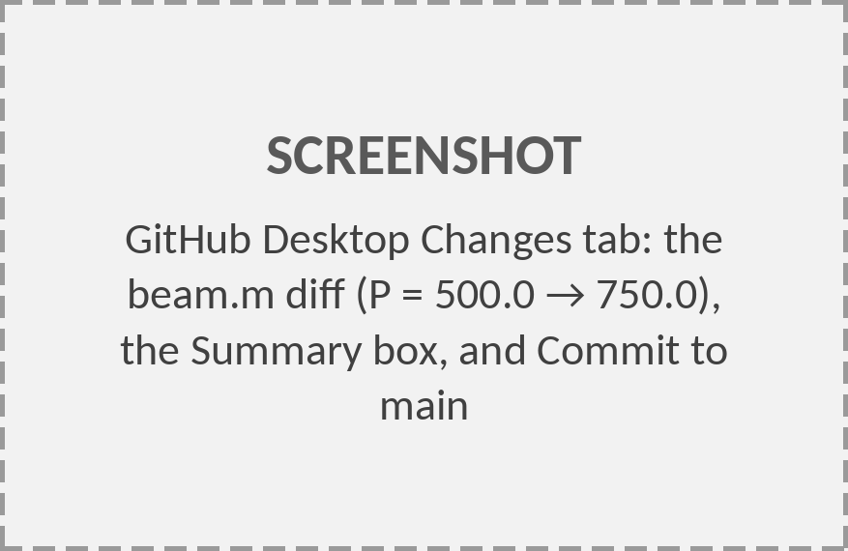
Exercise 3: Edit, Review, Commit
EXERCISE
1
Open beam.m in MATLAB, (or for faster editing: right-click Current Repository › Open in Visual Studio Code)
2
In beam.m change the load to P = 750.0; Save.
3
Back in Desktop, open the Changes tab and read the diff.
Commit
4
Summary: Increase tip load to 750 N. Click Commit to main.
5
Click Push origin. Refresh GitHub to see it.
beam.m
− P = 500.0; % N, tip load
+ P = 750.0; % N, tip load
Good commits: one logical change, with a summary that says what and why.
Notes:
The core loop: edit, review the diff, commit, push. Make them read the diff before committing; that is the same habit they'll need when reviewing agent output. A commit only saves locally; nothing reaches GitHub until Push. If you commit by mistake, Desktop shows an Undo button right after the commit.
Screenshot to add: GitHub Desktop Changes tab: the beam.m diff (P = 500.0 → 750.0), the Summary box, and Commit to main (Replace the gray placeholder: right-click › Change Picture › From a File.)

Slide 12
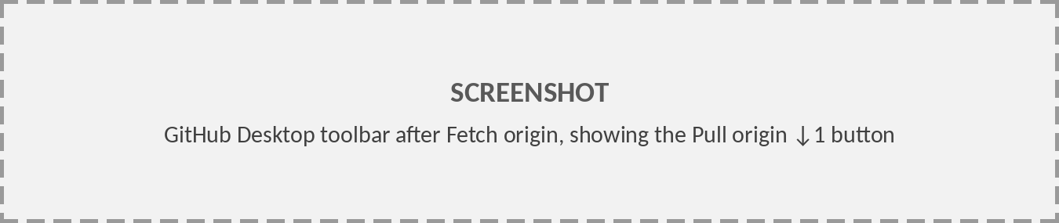
Exercise 4: Push, Fetch, Pull
Push origin
Fetch origin
Pull origin
Upload your commits to GitHub
Check GitHub for new commits. Files don’t change.
Download new commits into your files
EXERCISE
Simulate a teammate (or an agent) changing the repo:
Sync
1
On GitHub, open README.md › pencil icon. Add a line: Units: SI throughout.
2
Commit changes directly to main.
3
In Desktop: Fetch origin. The button changes to Pull origin ↓1.
4
Pull origin. Open README.md locally and confirm the new line.
Pull before you start. Push when you finish.
Notes:
Editing on github.com simulates a collaborator or an agent pushing a commit. Fetch only checks; it never changes your files. Pull brings the commits down. Habit: pull before you start working, push when you finish.
Screenshot to add: GitHub Desktop toolbar after Fetch origin, showing the Pull origin ↓1 button (Replace the gray placeholder: right-click › Change Picture › From a File.)

Slide 13
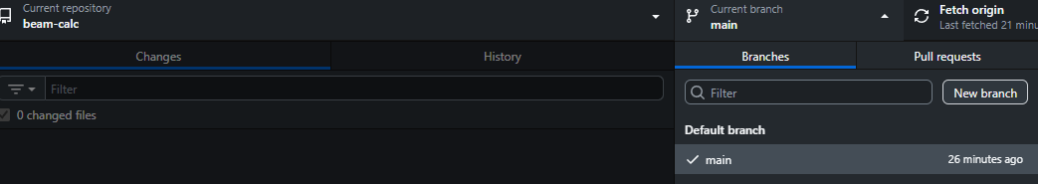
Exercise 5: Work on a Branch
EXERCISE
1
Current branch › New branch: feature/aluminum
Branch: a separate line of commits. main stays unchanged until the branch is merged.
Branches
2
In beam.m: E = 69e9; % Pa, aluminum
Switching branches swaps the files in your folder. Commit before you switch.
3
Commit to feature/aluminum.
4
Publish branch.
Coding agents always work on their own branch.
Why branch? A branch is a separate line of commits. Try a change (yours or an agent’s) without touching main; merge it when it works, or delete it and nothing is lost.
5
Switch Current branch to main. Look at beam.m.
Notes:
Have them switch back to main after committing on the branch and look at beam.m: it says steel again. Then switch to the branch: aluminum. Same folder, two versions. This is how an agent's work stays out of main until you approve it.

Slide 14
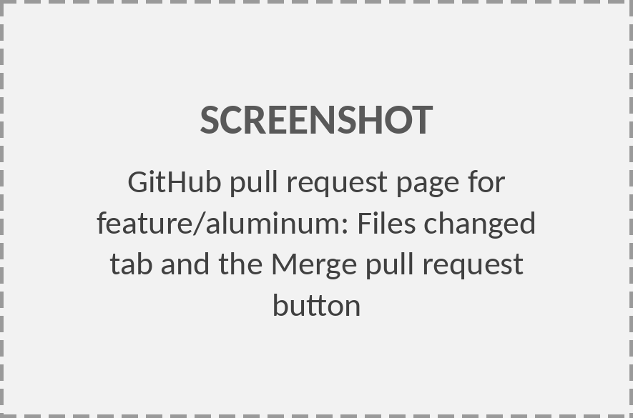
Exercise 6: Pull Request & Merge
EXERCISE
1
Switch to feature/aluminum. Branch › Create pull request . GitHub opens.
2
Add a title and one-line description. Create pull request .
3
Open Files changed. Review every line.
4
Merge pull request › Confirm. Then Delete branch .
Branches
5
In Desktop: switch to main, Pull origin.
A pull request (PR) asks to merge one branch into another. GitHub shows the diff, the commits, and a comment thread, so reviewers can comment line by line before anything reaches main. Nothing changes on main until someone clicks Merge. In Lesson 2, every change a coding agent makes arrives as a PR for you to review.
Notes:
The Files changed tab is where review happens. In Lesson 2 the agent opens this pull request for you; your job is everything from step 3 on. After merging, the local copy of main is behind GitHub until you pull.
Screenshot to add: GitHub pull request page for feature/aluminum: Files changed tab and the Merge pull request button (Replace the gray placeholder: right-click › Change Picture › From a File.)

Slide 15
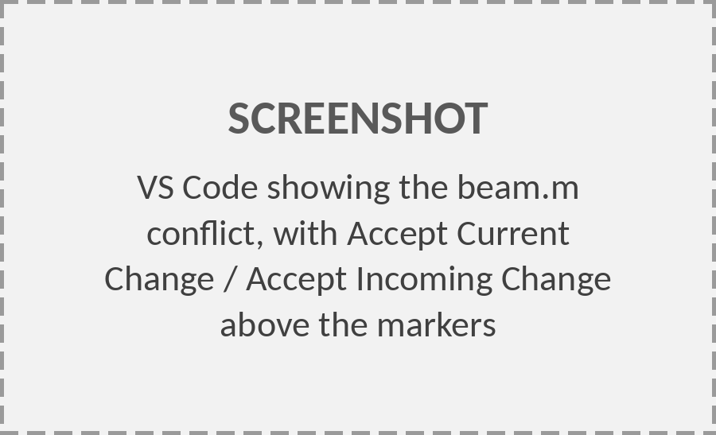
Exercise 7: Resolve a Conflict
A conflict happens when two commits change the same lines. You decide the result.
beam.m during the conflict
E = 200e9; % Pa
EXERCISE
<<<<<<< HEAD
1
On GitHub, edit beam.m on main: L = 2.5; . Commit.
L = 3.0; % m
=======
2
Locally, on main: L = 3.0; . Commit. Don’t pull first.
L = 2.5; % m
>>>>>>> origin/main
P = 750.0; % N
3
Push origin is rejected. Click Pull origin.
Conflicts
4
Desktop lists the conflicted file. Open in Visual Studio Code .
HEAD
your local version
origin/main
the version from GitHub
5
Keep one value, delete the markers, save.
6
Continue merge, then Push origin.
Notes:
Conflicts are normal and not an error. Git refuses to guess when two commits changed the same lines. In VS Code, the Accept Current / Accept Incoming buttons above the markers make this a click. The file must have no markers left before Desktop lets you continue the merge.
Screenshot to add: VS Code showing the beam.m conflict, with Accept Current Change / Accept Incoming Change above the markers (Replace the gray placeholder: right-click › Change Picture › From a File.)

Slide 16
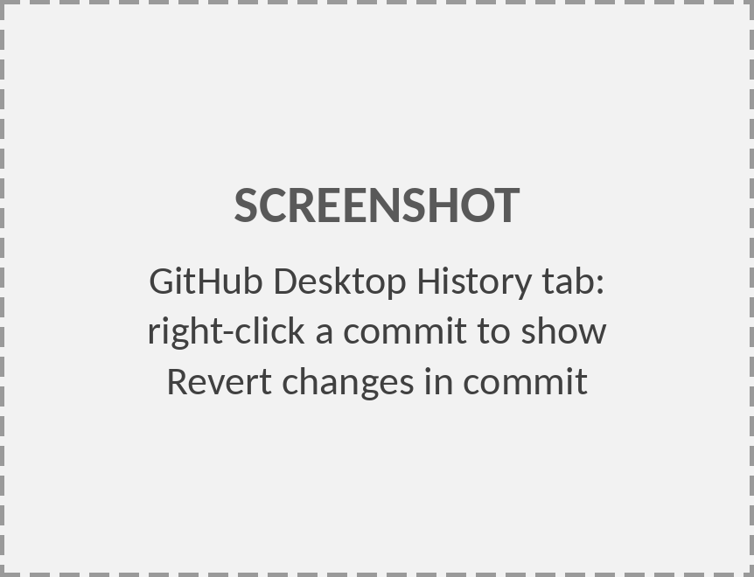
Exercise 8: History & Undo
Situation
What to do
GitHub Desktop
Not committed
Throw away edits to a file
Changes › right-click › Discard changes
Committed, not pushed
Take back the last commit; edits return to Changes
Undo button (below commit box)
Already pushed
Add a new commit that reverses an old one
History › right-click › Revert changes in commit
History
EXERCISE
1
Open the History tab. Click each commit to see its diff.
2
Right-click Increase tip load to 750 N › Revert changes in commit .
3
Check beam.m: P is back to 500. Push origin.
Notes:
Three levels of undo. Discard is for changes you haven't committed. Undo removes the last commit but only if it hasn't been pushed. Revert is the safe choice for anything already on GitHub: it adds a new commit that reverses the old one, so history stays intact. This is how you back out a bad agent commit.
Screenshot to add: GitHub Desktop History tab: right-click a commit to show Revert changes in commit (Replace the gray placeholder: right-click › Change Picture › From a File.)

Slide 17
README, .gitignore, AGENTS.md
README.md
.gitignore
AGENTS.md
What it is and how to run it. Shown on the repo’s GitHub page.
Files Git should never track: outputs, data, secrets.
Standing instructions Codex reads before every task. Covered in Lesson 2.
# beam-calc
Cantilever tip deflection.
## Run
In MATLAB: beam
## Test
runtests('tests')
Units: SI throughout.
# MATLAB
*.asv
*.mex*
slprj/
codegen/
# Outputs and data
results/
data/raw/
# Secrets
.env
# AGENTS.md
## Project
MATLAB R2024b,
no extra toolboxes.
## Conventions
- SI units; comment
units on every constant.
## Before committing
- Run runtests('tests')
Agent-Ready
Notes:
Three small files make a repo usable by people and agents. README tells anyone how to run it. .gitignore keeps generated files, data, and secrets out of commits. AGENTS.md is the instruction file Codex reads at the start of every task. We'll improve it in Lesson 2.

Slide 18
Public vs. Private & Data
Public
Private (default for this course)
Anyone on the internet can view and copy it.
Only you and people you invite.
Never commit
Remember
Passwords, API keys, tokens
History is permanent. Deleting a file later doesn’t remove it from past commits.
Student records, grades, PII
CUI or export-controlled data
Pushed a secret? Rotate it immediately.
Anything not cleared for release
Connecting a repo to an agent sends its contents to that service.
Agent-Ready
Follow current USAFA guidance on GenAI tools and data handling. Private is not the same as approved.
Notes:
Two points to stress. First, Git history is permanent: deleting a file in a later commit leaves it in every earlier commit. If a secret is pushed, assume it's compromised and rotate it. Second, connecting a repo to a coding agent sends its contents to that service. Follow current USAFA and DAF guidance on GenAI tools and data. A private repo is not an approval to store controlled data.

Slide 19
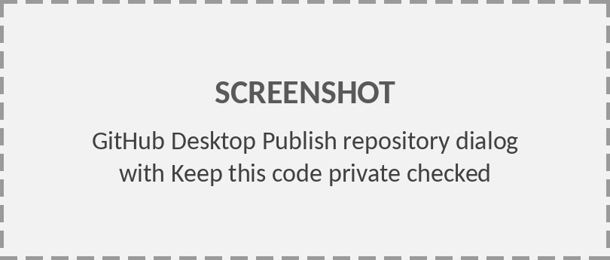
After Class: Your Own Repo
AFTER CLASS · BEFORE LESSON 2
Not a beam-calc exercise. After class, put one of your own projects on GitHub:
1
File › Add local repository › select the folder. Desktop says it isn’t a repo yet; click create a repository .
2
Set Git ignore to your language (e.g. MATLAB). This adds a .gitignore that keeps files MATLAB generates (autosaves, build output) out of every commit. Leave the rest as default. Click Create repository.
3
Desktop makes the first commit. Check the Changes tab for files that shouldn’t be there (data, outputs, passwords).
4
Publish repository. Leave Keep this code private checked.
Agent-Ready
5
Repository › View on GitHub to confirm it’s there.
Starting from nothing? File › New repository does steps 1–2 with an empty folder.
Notes:
Homework, not an in-class exercise. Participants do this after class with one of their own projects (scripts, models, course code) before Lesson 2. It sits just before the Agent-Ready Checklist so they see the steps that get them to its first item. Emphasize the private checkbox on Publish.
Screenshot to add: GitHub Desktop Publish repository dialog with Keep this code private checked (Replace the gray placeholder: right-click › Change Picture › From a File.)

Slide 20
Agent-Ready Checklist
Before Lesson 2, bring one of your own projects to this state:
Repo is on GitHub and private (steps on the previous slide)
main runs as-is (you’ve tested it)
README explains how to run it
.gitignore excludes outputs, data, and secrets
No sensitive data anywhere in history
Agent-Ready
You can branch, open a PR, merge, and pull
Optional: a first-draft AGENTS.md
Next: Lesson 2 · Agentic AI workflow: connect this repo to a coding agent and review its first pull request.
Notes:
Homework before Lesson 2: pick one of your own projects and bring it to this state. The previous slide has the steps for getting it onto GitHub. Lesson 2 starts from a repo that meets this checklist.

Slide 21
Troubleshooting
Symptom
Fix
Push rejected; Desktop shows Pull origin
GitHub has newer commits. Pull, resolve any conflict, then push.
Repo missing from Clone list
Check the signed-in account (Options › Accounts) or paste the URL in the URL tab.
Authentication failed
Sign out and back in under Options › Accounts.
Can’t switch branch or pull: uncommitted changes
Commit them, or choose to stash them when Desktop asks.
Committed to the wrong branch
Not pushed: Undo, switch branch, commit again.
Review
Unwanted files in Changes
Right-click › Ignore file (adds it to .gitignore).
Files flicker or duplicate
Repo is in a OneDrive-synced folder. Re-clone to a local path.
Pushed a password or key
Rotate it now. Deleting the file doesn’t remove it from history.
Notes:
The first row is the one everyone hits. Desktop is telling you GitHub has commits you don't. Pull first, then push.

Slide 22
Quick Reference
To…
In GitHub Desktop
Get a repo from GitHub
File › Clone repository
Track an existing folder
File › Add local repository › create a repository
Put it on GitHub
Publish repository (keep private)
Save a snapshot
Changes tab › Summary › Commit to <branch>
Send commits
Push origin
Get the latest
Fetch origin › Pull origin
Start a branch
Current branch › New branch › Publish branch
Review
Use someone’s branch
Fetch origin › Current branch › pick it
Propose a merge
Branch › Create pull request
Undo a pushed commit
History › right-click › Revert changes in commit
Edit the code
Repository › Open in Visual Studio Code
Notes:
Leave this up during open exercise time. Participants can print it or keep it as a reference for Lesson 2.

Slide 23
Knowledge Check
1
You edited beam.m, but the change doesn’t appear on GitHub. What did you skip?
2
What is the difference between Fetch and Pull?
3
Why should a coding agent work on a branch instead of main?
4
Push origin is rejected. What do you do?
5
You pushed a file containing an API key, then deleted it in the next commit. Is the key safe?
Review
Answers in slide notes.
Notes:
Answers.
1: The change was saved but not committed and pushed; check the Changes tab, commit, then Push origin.
2: Fetch checks GitHub for new commits without changing your files; Pull downloads them and updates your files.
3: A branch keeps main working while the change is reviewed; nothing reaches main until the pull request is merged.
4: Pull origin, resolve any conflicts, then push.
5: No. The key is still in history and must be treated as compromised; revoke and replace it.

